Slide 1
Physical Chemistry
Ying Hu
(Fifth edition)
Bilingual Program
版权所有：华东理工大学物理化学教研室

Slide 2
Preface
Bottom
Molecular approach
Microscopic
level
Quantum theory and spectroscopy
From
microscopic
to
macroscopic
level
Statistical thermodynamics
Macroscopic
level
Chemical rates
Equilibrium thermodynamics
Extension (Special topics)
Up

Slide 3
Part IV Statistics
Chapter 12 Statistical Mechanics of Independent Particle Systems
Bilingual Program
版权所有：华东理工大学物理化学教研室

Slide 4
Framework of the Chapter
  12.1 Introduction
  I. Principles of Statistical Mechanics
  12.2 Description of Microscopic States
  12.3 Fundamental Postulates of Statistical Mechanics
  12.4 The Most Probable Distribution
  II. Statistical Distributions of Independent-Particle Systems
  12.5 Maxwell-Boltzmann Distribution
  12.6 Molecular Partition Function
  III. Thermodynamic Properties of Independent-Particle Systems
  12.7 Thermodynamic Functions of Independent-Particle Systems
  12.8 Standard Molar Heat Capacity of Gases
  12.9 Heat Capacity of Crystals
  12.10 Standard Molar Entropy of Gases
  12.11 Standard Equilibrium Constant of Gaseous Reactions

Slide 5


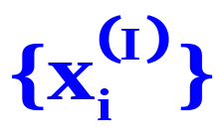
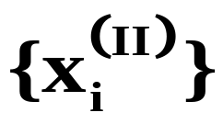
1. Macroscopic State and Microscopic State
In a certain state, various macroscopic properties have certain fixed values. Microscopically, the microscopic state {x_{i}} of the whole system continuously changes.
T
P

Slide 6
Statistic!
What is the statistical mechanism ?
Distribution
Macroscopic State
Microscopic States

Slide 7


A Simplified Example
Macroscopic State
N=3, E=4
Microscopic State
Energy level ：Z=0， A=1， B=2
Degeneracy ： g_{z}=1，g_{A}=1，g_{B}=2
Number of molecules
0， 2， 1
1， 0， 2
Distribution
Z
B
A
Z(0)A(2)B(1); Z(1)A(0)B(2)

Slide 8
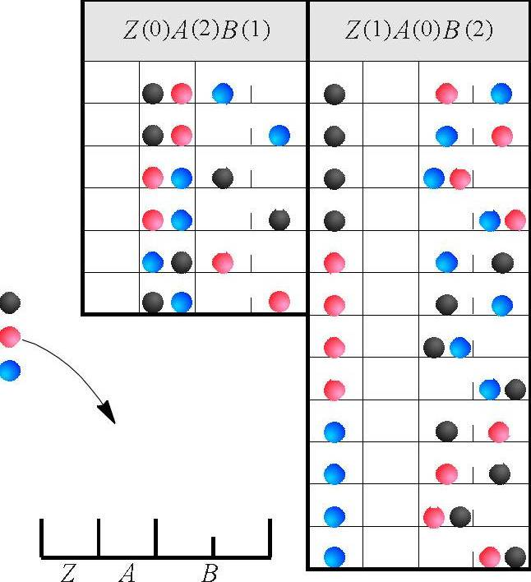
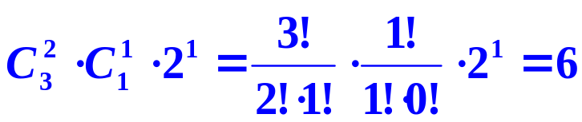
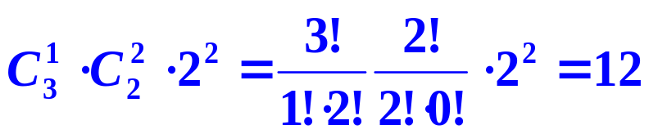




12.4 The Most Probable Distribution
Calculations for the Number of Microscopic States, ω
Z(0)A(2)B(1)：
Z(1)A(0)B(2)：
The number of all probable microscopic states, Ω , is 18
The probability
Z(0)A(2)B(1)
Z(1)A(0)B(2)

Slide 9
Framework of the Chapter
General principles of equilibrium at the transition level
from microscopic to macroscopic
Fundamental postulates and methods
Principles of Statistical Mechanics
Maxwell-Boltzmann Distribution
Fundamental
equation
Prediction of macroscopic properties
from microscopic characteristics
Applications

Slide 10
Framework of the Chapter
General principles of equilibrium at the transition level
from microscopic to macroscopic
I. Principles of Statistical Mechanics
II. Statistical Distributions of Independent Particle Systems
III. Thermodynamic Properties of Independent-Particle Systems
Description of Microscopic States
Thermodynamic Functions
Maxwell-Boltzman Distribution
  Standard Heat Capacity of Gases
Fundamental Postulates of Statistical Mechanics
  Standard Entropy of Gases
The Most Probable Distribution
  Molecular Partition Function
  Heat Capacity of Crystals
  Standard Equilibrium Constant

Slide 11
1. General Principles of Statistical Mechanics
(1) The movement of a single microscopic particle is a mechanical phenomenon with reversibility and has no meaning of the temperature. The particles in the system transport energy among one another by collisions or radiations
(2) Macroscopic substances are composed of a large number of microscopic particles and exhibit temperature. Heat transfer occurs between substances with different temperatures. These processes are thermal phenomena.

Slide 12
(3) The object of statistical mechanics is to descript macroscopic systems composed of a large number of microscopic particles, to obtain macroscopic properties from the corresponding microscopic properties of particle movement using the method of statistical average.
(4) When applying statistical mechanics to study macroscopic properties, the characteristic properties of matter should be imported.

Slide 13
12.1 Introduction
2. Vocabulary
Statistical Physics
- statistical mechanics.
Statistical Thermodynamics
- equilibrium statistical mechanics
Independent-Particle System
A system composed of particles without any interactions among them except the elastic collisions
Dependent-Particle System
A system with interactions among the composed particles.
Non-Localized-Particle System
A system in which the composed particles can move in the whole space of the system, for example an ideal gas.
Localized-Particle System
A system in which the composed particles can move only in a small region around fixed positions, such as the atoms in crystal

Slide 14
I. Principles of Statistical Mechanics
Bilingual Program
版权所有：华东理工大学物理化学教研室

Slide 15
Framework of the Chapter
I. Principles of Statistical Mechanics
  12.2 Description of Microscopic States
  12.3 Fundamental Postulates of Statistical Mechanics
  12.4 The Most Probable Distribution

Slide 16
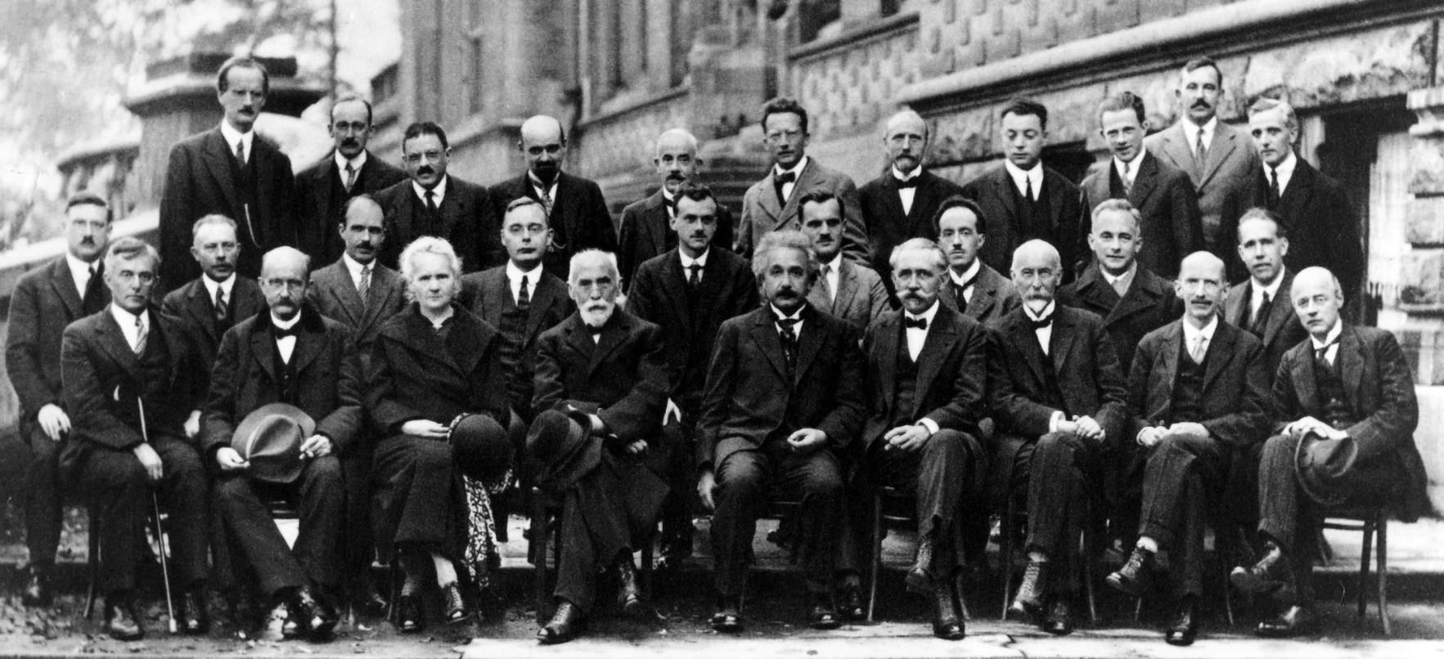
1. Macroscopic State and Microscopic State
A microscopic state is the sum of the instantaneous moving status of every one of the molecules or particles in a system at a certain time, and is determined by the quantum mechanical states of every molecule.
后排左起：A.皮卡尔德（A.Piccard）E.亨利厄特(E.Henriot）P.埃伦费斯特（P.Ehrenfest）Ed.赫尔岑（Ed.Herzen） Th.顿德尔（德康德）（Th. de Donder）E.薛定谔（E.Schrodinger） E.费尔夏费尔德（E.Verschaffelt） W.泡利（W.Pauli）W.海森堡（W.Heisenberg） R.H.否勒（R.H. Fowler） L.布里渊（L.Brillouin ）
中排左起：P.德拜（P.Debye） M.克努森（M.Knudsen） W.L.布拉格(W.L.Bragg） H.A.克莱默（H.A.Kramers） P.A.M狄拉克（P.A.M.Dirac） A.H.康普顿（A.H.Compton ） L.德布罗意（L. de Broglie） M.波恩（M.Born） N.玻尔（N.Bchr ）
前排左起：I.朗缪尔（I.Langmuir） M.普朗克（M.Planck M.居里夫人（Mme Curie ）H.A.洛伦兹(H.A.Lorentz) A.爱因斯坦（A.Einstein） P.朗之万（P.Langevin）Ch.E.古伊（Ch.E.Guye） C.T.R.威尔逊（C.T.R.Wilson）O.W.里查逊（O.W.Richardson)

Slide 17
2. Classification of Molecular Movements
External Movements
Translational motion of the molecule as a whole.
The types of energy include
Translational energy ε_{t}, Interaction potential energy ε_{p}
Internal Movements
The relative motions of the particles composing a molecule
They can be distinguished by
Molecular Rotation ε_{r} , Molecular Vibration, ε_{v}
Electrons moving around the nucleus, Electron spin in an atom, ε_{e}
Nuclear spin and the movements of particles inside the nucleus. ε_{n}

Slide 18
Thermal Movements
Both the external and internal energies of motion exhibit a temperature dependent distribution.
Thermal Movements
Forms of
Motion
Translational, Rotational, Vibrational motions
Non-thermal movements (at normal temperature range)
Electronic, Nuclear motions
Degree of Freedom of Movement
For a molecule composed of n atoms, the molecule has 3n degrees of freedom of thermal motion.

Slide 19
Degree of Freedom of Motion
3n degrees of freedom of motion
 | Diatomic molecules | Multi-atom molecules | Linear Multi-atom molecules
Translational (x, y, z) of the center of mass | 3 | 3 | 3
Rotational (three axes) | 2 | 3 | 2
Vibrational | 1 | 3n-6 | 3n-5

Slide 20
3. Classical Mechanical Description of Microscopic States
Generalized Coordinates and Generalized Momenta
For every one degree of freedom, i, a generalized coordinate q_{i} and a generalized momentum p_{i} can describe its moving state.
 | Coordinate | Momentum
Translational (in x direction) | coordinate x | partial momentum p_{x}
Rotational (around one axis) | azimuth θ | angular momentum p_{r}
Vibration (of two particles ) | relative distance d | relative momentum p_{v}
Notes:
* 一切粒子的在某个自由度的各个属性（能量，角动量）均可由此自由度上的坐标和动量表示出来

Slide 21
4. Quantum Mechanical Description of Microscopic States
Microscopic States of Independent-Particle Systems
translational
rotational
vibrational
electronic and nuclear
The microscopic state
(quantum state)
wave function
Independent particle system
the product of the N molecular wave functions

Slide 22
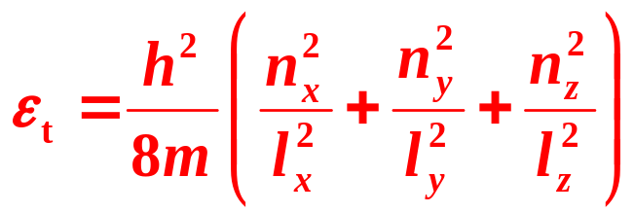

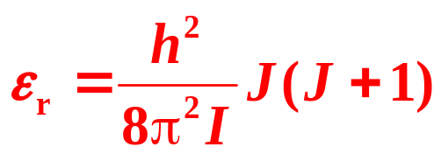

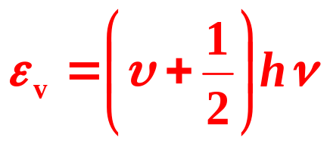

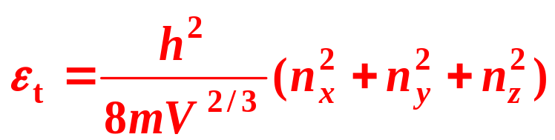
Energy levels (Planck constant h = 0.66260755×10⁻³³J s)
 | Energy level | Quantum numbers
Translation
Rotation of a linear molecule
Vibrational mode
For a cubic box, l_{x} =l_{y} =l_{z} =V^{1/3}

Slide 23
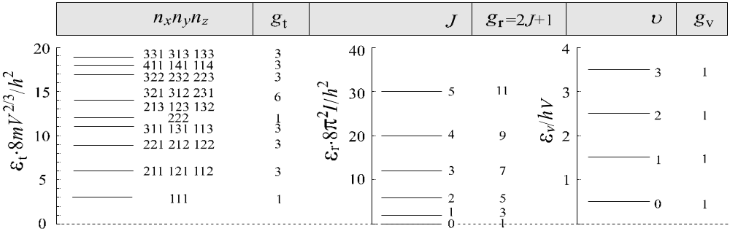



Energy-Level Spacing
A N₂ molecule moving in a container with a volume of V=10⁻⁶ m³
k, Boltzmann constant, 13.80658×10⁻²⁴J⋅K⁻¹
Degenerate energy level, quantum states having the same energy,
Degeneracy, the number of these quantum states.

Slide 24
Energy-Level Spacing
The spacing of translational energy levels is so small that the levels can be treated approximately as a continuous variable.
The vibrational energy levels have equal spacing between the neighboring levels. When v = 0, ε₀ = hν/2 called the zero point energy. The vibrational energy levels for one mode are non-degenerate.
The rotational energy levels are degenerate with degeneracy is 2J+1.

Slide 25
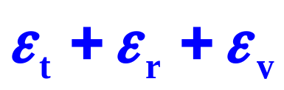
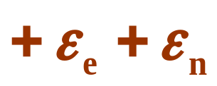






Molecular Energy Levels
Energy level
Degeneracy
Dependent-Particle Systems
Intermolecular interactions
External movements
Classical mechanics
Internal movements
Quantum mechanics

Slide 26
Framework of the Chapter
I. Principles of Statistical Mechanics
  12.2 Description of Microscopic States
  12.3 Fundamental Postulates of Statistical Mechanics
  12.4 The Most Probable Distribution

Slide 27
  12.3 Fundamental Postulates of Statistical Mechanics
General fundamental postulates
Thermodynamics has four laws,
Quantum mechanics has four fundamental postulates,
Statistical mechanics has three fundamental postulates.
The three fundamental postulates
1. The First Postulate:
A macroscopic state corresponds to a certain, generally a large number of microscopic states, each of them appears in terms of a certain probability.

Slide 28
  12.3 Fundamental Postulates of Statistical Mechanics
System
·
·
Classical mechanics Quantum mechanics
·
Several molecules
·
·
Any change of
coordinate, momentum, or quantum state
A large number of the microscopic states
A large number of molecules
Constraints inherent in the macroscopic state (e.g., constant N, T)
The relevant number of states is limited
The change of the microscopic states observes statistical principles
Statistical principles

Slide 29
  12.3 Fundamental Postulates of Statistical Mechanics
2. The Second Postulate:
A macroscopic mechanical quantity is the statistical average of the corresponding microscopic quantities.
Mechanical Quantities and Non-Mechanical Quantities
Mechanical quantities, have corresponding microscopic properties at molecular level. These quantities include energy, density, pressure.
Non-mechanical quantities, do not have corresponding microscopic properties. These quantities include temperature, entropy, Gibbs function, chemical potential.

Slide 30
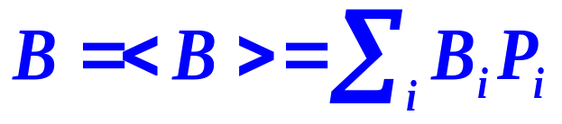
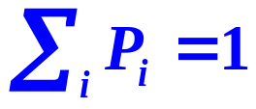
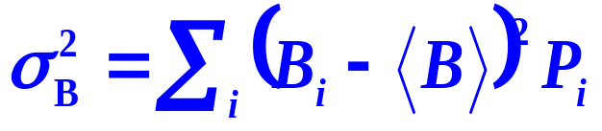
  12.3 Fundamental Postulates of Statistical Mechanics
Mathematical Expression of the Second Postulate
B, mechanical quantity
B_{i}, microscopic quantity
i, microscopic state
P_{i}, the probability
< >, the statistical average
Fluctuations about the Average
The microscopic quantity B_{i} of the mechanical quantity B does not equal <B> , but fluctuates around it.

Slide 31
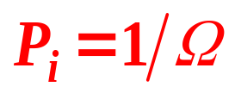
  12.3 Fundamental Postulates of Statistical Mechanics
3. The Third Postulate:
Every one of the microscopic states in an isolated system has an identical probability of appearance.
Postulate of equal a priori probabilities
In the case of molecules completely isolated from the external influences, any microscopic state will not appear preferentially (a priori).
N, E and V are kept unchanged, Ω is the total number of the microscopic states for a macroscopic state,

Slide 32
Framework of the Chapter
I. Principles of Statistical Mechanics
  12.2 Description of Microscopic States
  12.3 Fundamental Postulates of Statistical Mechanics
  12.4 The Most Probable Distribution

Slide 33

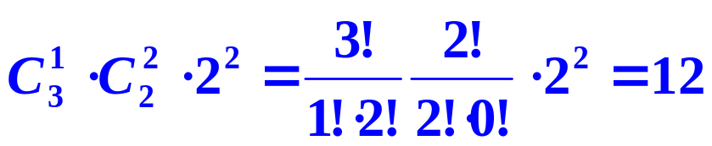
12.4 The Most Probable Distribution
Calculations for the Number of Microscopic States, ω
Z(0)A(2)B(1)：
Z(1)A(0)B(2)：
The number of all probable microscopic states, Ω , is 18
The probability
Z(0)A(2)B(1)
Z(1)A(0)B(2)

Slide 34
12.4 The Most Probable Distribution
1. Distributions in Independent-Particle Systems
In terms of Energy Levels
A distribution of molecules on energy levels with serial numbers i
Energy level ε₀, ε₁, ε₂, …
Degeneracy g₀, g₁, g₂, …
Number of molecules N₀, N₁, N₂, …
In terms of Quantum States
A distribution of molecules on quantum states with serial numbers h
Energy of the quantum state ε₀, ε₁, ε₂, …
Number of molecules N₀, N₁, N₂, …

Slide 35
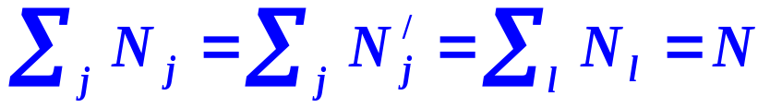
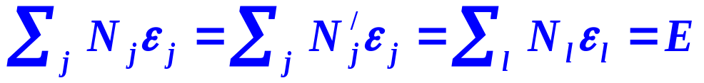
12.4 The Most Probable Distribution
Constraints
A system is in a certain macroscopic state
(A total number of molecules N, an energy E and a volume V)
Energy level |  | ε₀, | ε₁ | ε₂ | …
Degeneracy |  | g₀ | g₁ | g₂ | …
Number of molecules | t=t | N₀ | N₁ | N₂ | …
 | t=t’, | N₀’ | N₁’ | N₂’ | …
Different distributions must satisfy the following two constraints
Conservation of particle
Conservation of energy
Identical average energies
Fixed volume is reflected in the energy of the energy levels or quantum states

Slide 36
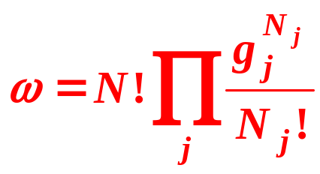
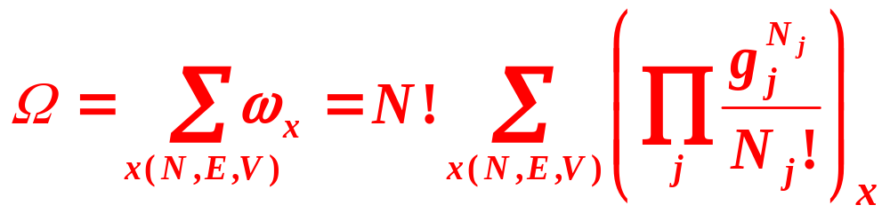
12.4 The Most Probable Distribution
Arbitrary Distributions in terms of Energy Levels
Energy level ε₀, ε₁, ε₂, …
Degeneracy g₀, g₁, g₂, …
Number of molecules N₀, N₁, N₂, …
The number of microscopic states
A Macroscopic State with Fixed N, E, and V
The total number of microscopic states Ω

Slide 37
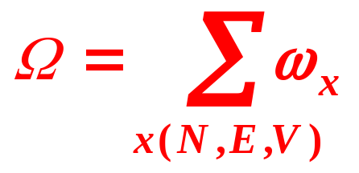
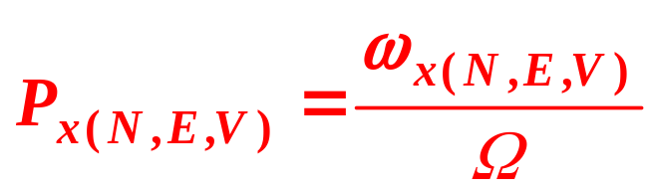
12.4 The Most Probable Distribution
3. Thermodynamic Probability
Thermodynamic Probability
The number of microscopic states ω possessed by a distribution x(N,E,V).
The number of total microscopic states Ω possessed by a macroscopic state.
Probability
Probability P_{x(N,E,V)}

Slide 38
12.4 The Most Probable Distribution
3. Thermodynamic Probability
For a macroscopic state, it is possible to have various distributions (configurations).
Each distribution contains a certain number of microscopic states, ω.
A macroscopic state covers a fixed number of microscopic states, Ω.

